Slide 1
Salesforce1: Your first Visualforce Global Publisher Action
Hands-On Workshop 100
Salesforce.com
Follow us @forcedotcom
Notes:
Welcome to this hands-on workshop. Get ready to learn, hands-on.

Slide 2
Safe harbor
Safe harbor statement under the Private Securities Litigation Reform Act of 1995:
This presentation may contain forward-looking statements that involve risks, uncertainties, and assumptions. If any such uncertainties materialize or if any of the assumptions proves incorrect, the results of salesforce.com, inc. could differ materially from the results expressed or implied by the forward-looking statements we make. All statements other than statements of historical fact could be deemed forward-looking, including any projections of product or service availability, subscriber growth, earnings, revenues, or other financial items and any statements regarding strategies or plans of management for future operations, statements of belief, any statements concerning new, planned, or upgraded services or technology developments and customer contracts or use of our services.
The risks and uncertainties referred to above include – but are not limited to – risks associated with developing and delivering new functionality for our service, new products and services, our new business model, our past operating losses, possible fluctuations in our operating results and rate of growth, interruptions or delays in our Web hosting, breach of our security measures, the outcome of intellectual property and other litigation, risks associated with possible mergers and acquisitions, the immature market in which we operate, our relatively limited operating history, our ability to expand, retain, and motivate our employees and manage our growth, new releases of our service and successful customer deployment, our limited history reselling non-salesforce.com products, and utilization and selling to larger enterprise customers. Further information on potential factors that could affect the financial results of salesforce.com, inc. is included in our annual report on Form 10-Q for the most recent fiscal quarter ended July 31, 2012. This documents and others containing important disclosures are available on the SEC Filings section of the Investor Information section of our Web site.
Any unreleased services or features referenced in this or other presentations, press releases or public statements are not currently available and may not be delivered on time or at all. Customers who purchase our services should make the purchase decisions based upon features that are currently available. Salesforce.com, inc. assumes no obligation and does not intend to update these forward-looking statements.

Slide 3
Agenda
Add Visualforce page for Global Publisher Action
Run your Visualforce page through Salesforce1 Global Publisher Action
Get a Developer Edition org
Complete the hands-on exercises
Q & A
Notes:
This workshop is simple. After I finish providing you with this brief overview of the workshop scope, I will guide you through getting a new Developer Edition organization. Even if you already have one, it’s a good idea to get a new one now. After that, you’ll complete a series of exercises using the workbook. It should take you about 30minutes to complete the exercises. If you run out of time, don’t worry, there’s a few extra minutes between each workshop, and you can always finish on your own time later.
If you have any questions while you complete the exercises, just raise your hand and one of the staff here will be happy to assist you.

Slide 4
Global Publisher Layout
Notes:
Before you learn what you’ll be doing, let’s first focus on the feature that you’ll be working with today.
Salesforce1 is need today. It has been reached more than 100K downloads yet and still counting. With Salesforce1, you have everything on your mobile device and in much friendly format. In Salesforce1 app, Global Actions are tremendously time saver as they allow you to perform your global action from the complete app. No matter on which screen you are, you can always run your global actions. Salesforce1 comes with some predefined global actions like Feed, Log a Call, New Task, Files etc. In this tutorial, we will tell you how you can add a Visualforce page to your global publisher action.

Slide 5
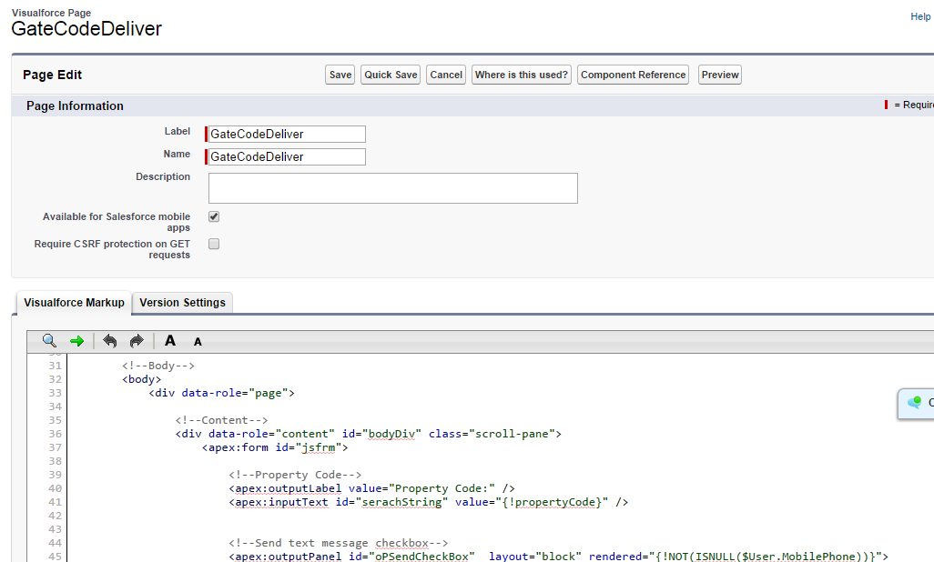
Create a sample Visualforce page
Notes:
Create a simple Visualforce page. Keep it very easy.

Slide 6
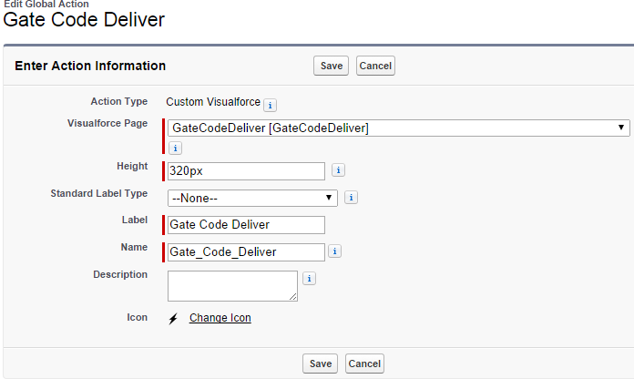
Add your Visualforce global action
Notes:
After creating the Visualforce page,
Navigate to Your Name -> Setup -> Build -> Create -> Global Actions -> Actions
Click on “New Action”, select attributes as displayed in the Screenshot.
Select your Visualforce Page from dropdown
Save Action.

Slide 7
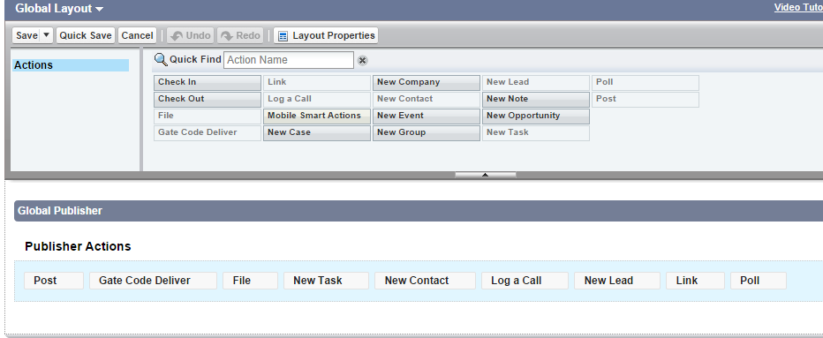
Add your Global action on Global publisher layout
Notes:
After creating the Global Action,
Navigate to Your Name -> Setup -> Build -> Create -> Global Actions -> Publisher Layout
Click on “Edit” link of “Global Layout.
Add your Global Action in Publisher Actions section.
Save layout.

Slide 8
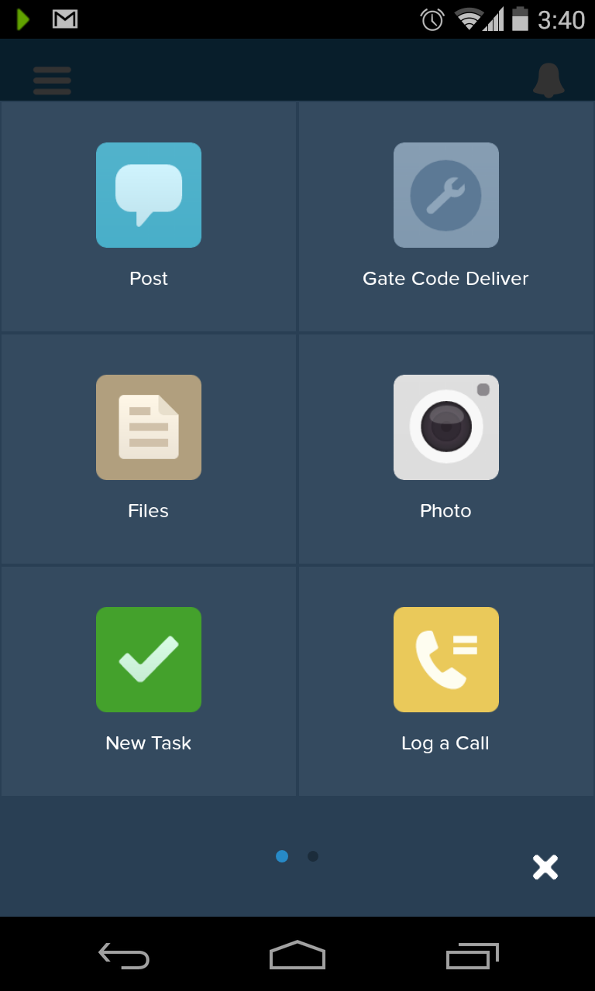
Login into Salesforce1 app
Notes:
Now login to your Salesforce1 app from your mobile or tablet device.
Click on +(Plus) sign on the bottom right hand corner.
Verify that your Global Action is being displayed.
Click on Action.

Slide 9
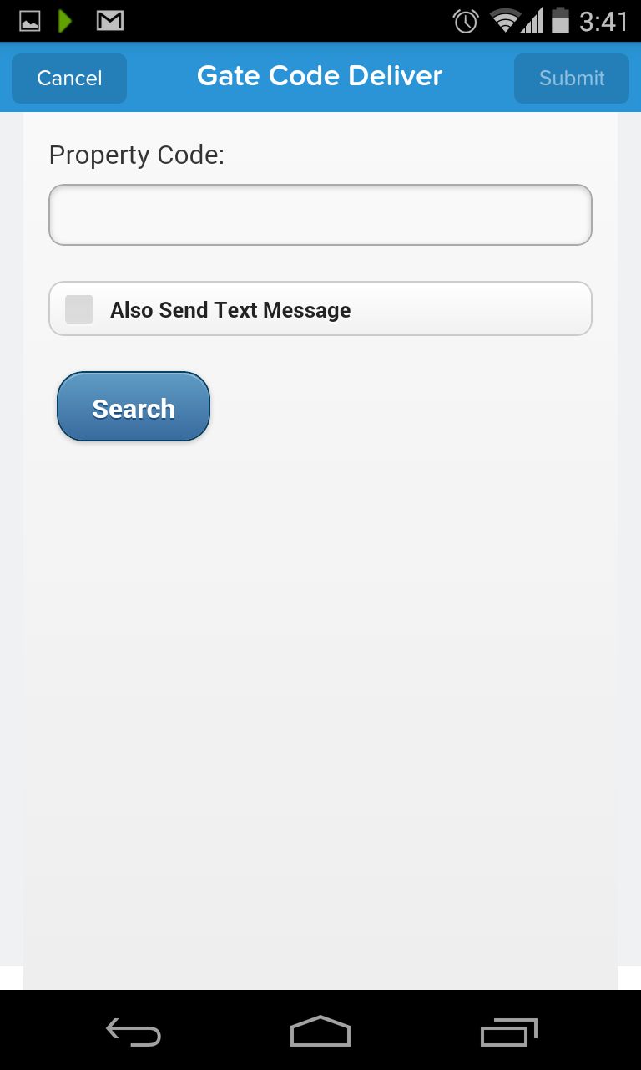
Run your Visualforce page
Notes:
Once you select your global action, verify your Visualforce page is being displayed. Isn’t it cool? It’s awesome, reason is, now you can adjust your global actions as per the need. You can use predefined actions, you can create new global action using standard components and you can create global actions using custom pages and bind your business logic behind the scene.

Slide 10
Ready, set, go
Time to develop
Notes:
That’s it for the introduction. Now it’s time to turn to your workbook and start developing.

Slide 11
Get a Developer Edition Org
Sign up: http://bit.ly/cctlondondevzone
Email: an email address you can check right now
Username: can be anything formatted as an email address:
ex) <your_name>@customer_tour_london.com
Notes:
The first thing you need to do is get a new DE org. A lot of people think they have a DE org and they don’t. Or think they’ll just use their company org, which is usually a mistake. Everyone should get a new DE org now.
[Walk them through this.]

Slide 12
Q&A
Raise your hand
Notes:
Remember, if you have any questions, please raise your hand and someone will come by to help.
KEEP THIS SLIDE UP DURING EXERCISE TIME

